Slide 1
Model-based RL, planning, and searching

Slide 2
Overview
Recap
Model-based RL
Monte Carlo Tree Search (MCTS)
Planning in psychology

Slide 3

Recap
Model-based
Model-free
Value-based
MDP
Policy iteration
Value iteration
Off-policy
Q learning
DQN
On policy
Sarsa
…
A lack of a model
A large state space
Actor-critc:
A2C, TRPO, PPO
Search
Policy-based
REINFORCE

Slide 4
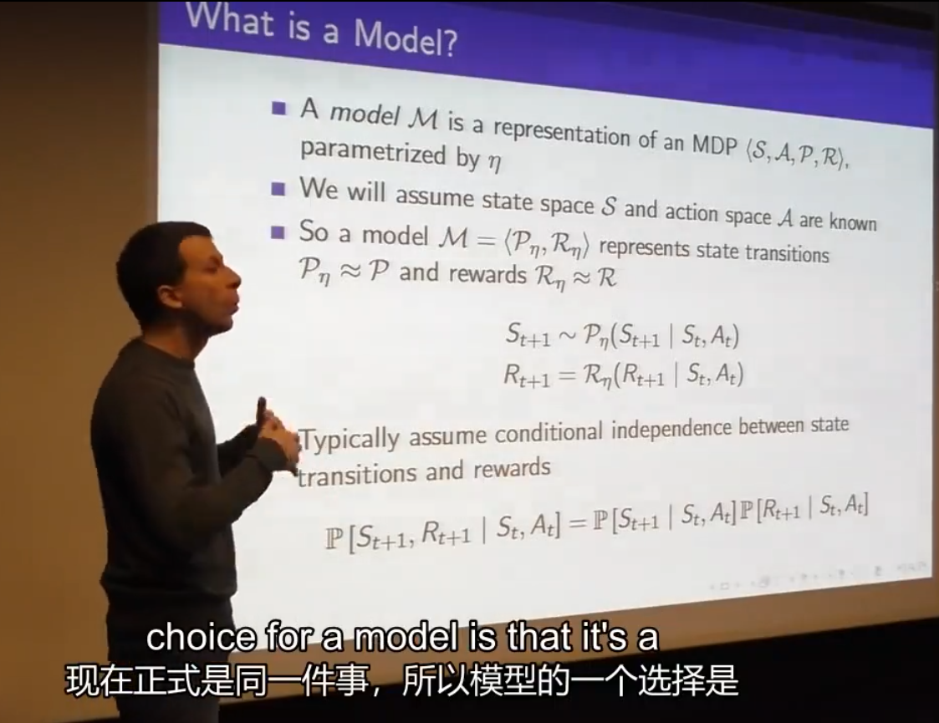
What is a model?

Slide 5


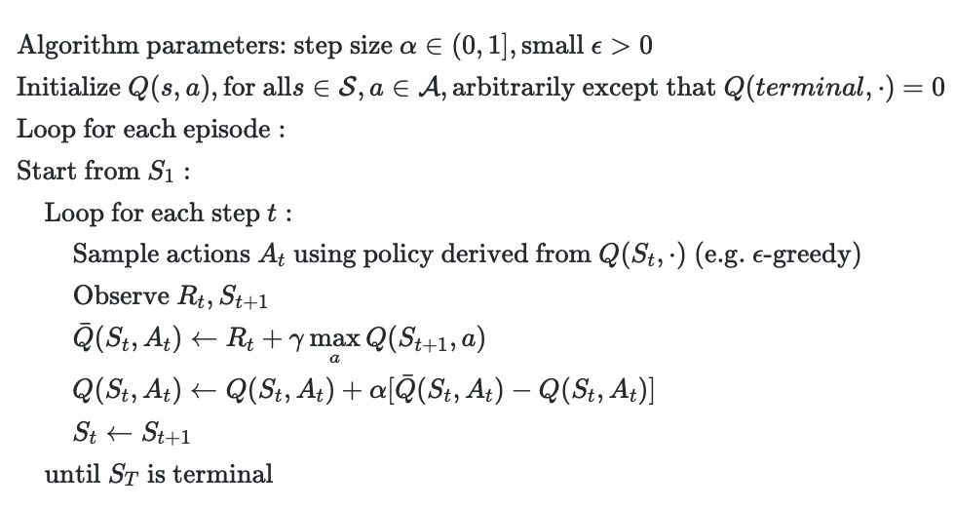


Model-free RL semantics
Agent
s
a
r
Environment

Slide 6
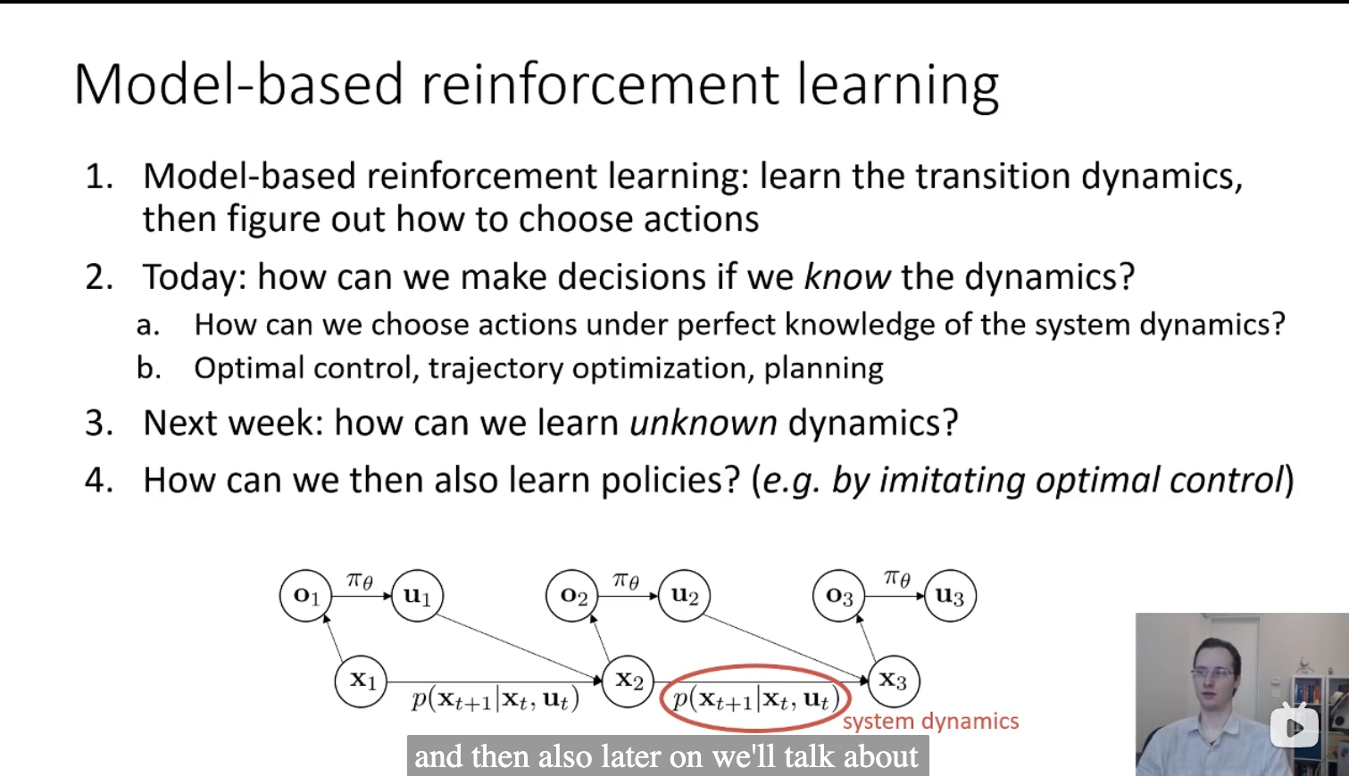
Basic research problems in model-based RL

Slide 7
Basic research problems in model-based RL
What can we do if we know the models?
Planning
How can we learn an unknown model?
How can we then decide a policy?

Slide 8


What is planning?
Agent
s
r
a
s
a
r
Environment

Slide 9


The semantic of learning
Reality

Slide 10


The semantic of planning
Reality
Imagination

Slide 11


What is planning?
Learning refers to the computational process that produces or improves a policy by gaining real-world experience through interaction with the environment.
Planning entails producing or improving a policy by utilizing simulated experiences derived from interactions with a modeled environment.

Slide 12
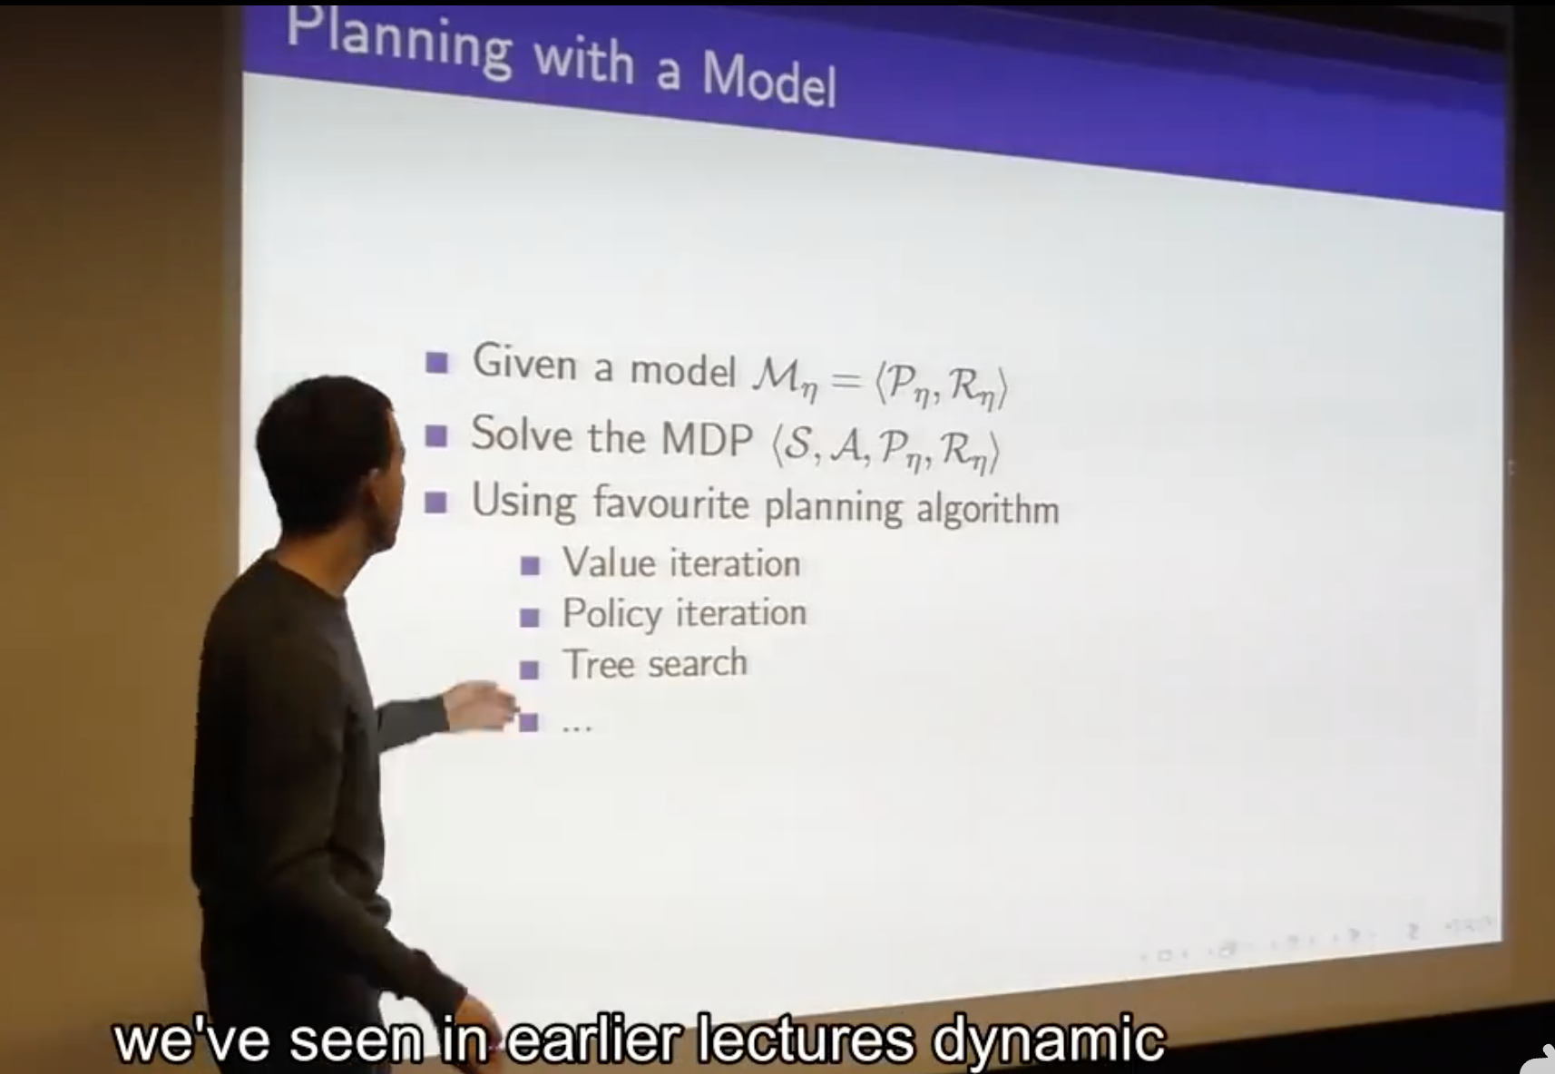
Heuristic search

Slide 13
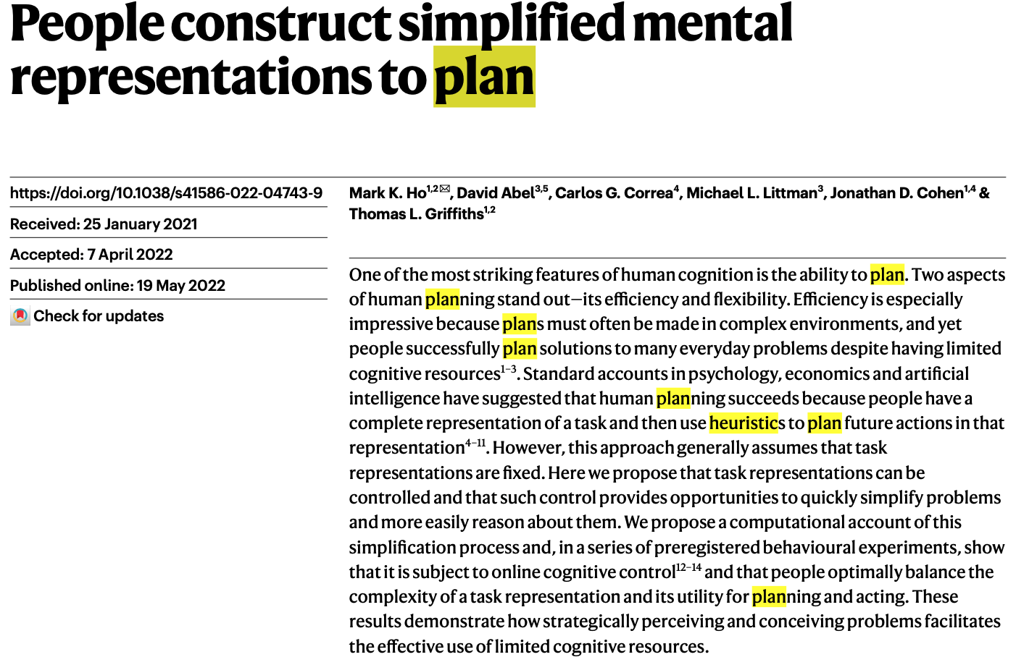


Slide 14
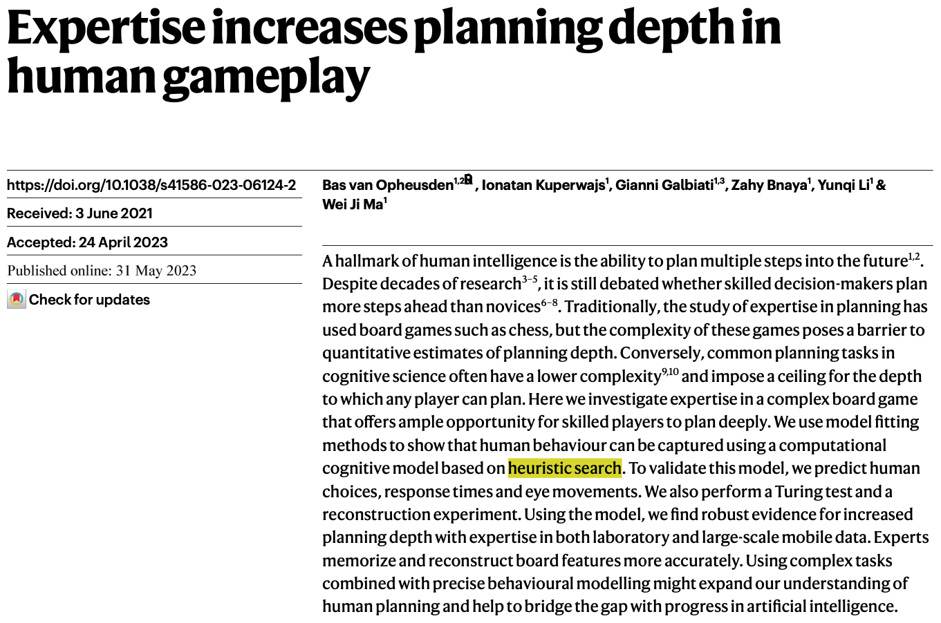


Slide 15
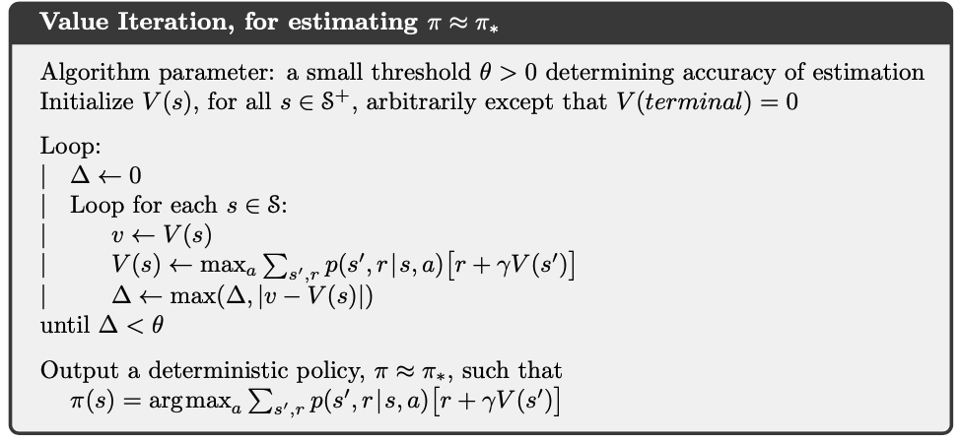


Heursitc search
What’s wrong with the dynamic programming?

Slide 16
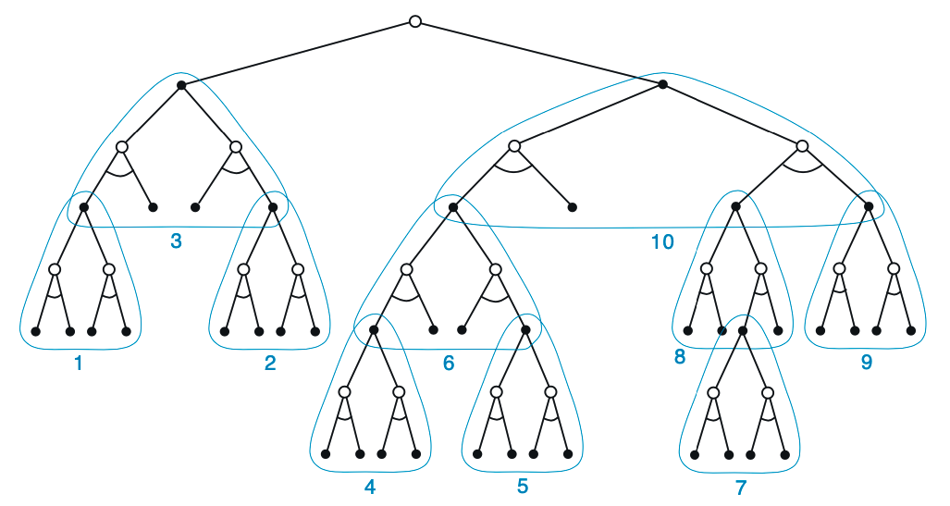
Heursitc search (Decision time forward search)
Root
For each state enounctered, a large tree of possible continuations is considered.
The apprxomiate value function is applied to the leaf nodes.
The value is backed up towards the root from leaves.
The backup stops at the state-action nodes for the current state.
Node
Parent
Child
Leave
How to approximate value without full tree?

Slide 17


Monte Carlo Tree Search (MCTS)
S_{t}
a=0
a=1
a=1
S_{t+1}
S_{t+1}
S_{t+1}
S_{t+2}
S_{t+2}
S_{t+2}
S_{t+2}
S_{t+2}
S_{t+2}

Slide 18
Monte Carlo Tree Search (MCTS)
S_{t}
a=1
a=0
a=1
Q=10
Q=5
Q=1
S_{t+1}
S_{t+1}
S_{t+1}
S_{t+2}
S_{t+2}
S_{t+2}
S_{t+2}
S_{t+2}
S_{t+2}

Slide 19
Monte Carlo Tree Search (MCTS)
S_{t}
Select & expand
Rollout
Backpropagate

Slide 20
Monte Carlo Tree Search (MCTS)
S_{t}
a=0
Select & expand
S_{t+1}
Rollout
Backpropagate
R = -1

Slide 21
Monte Carlo Tree Search (MCTS)
S_{t}
a=0
Select & expand
S_{t+1}
Rollout
Backpropagate
R = -1

Slide 22
Monte Carlo Tree Search (MCTS)
V += -1
N += 1
S_{t}
V += -1
N += 1
a=0
Select & expand
V += -1
N += 1
S_{t+1}
Rollout
Backpropagate
R = -1

Slide 23
Monte Carlo Tree Search (MCTS)
S_{t}
a=0
a=1
Select & expand
S_{t+1}
S_{t+1}
Rollout
Backpropagate
R = -1
R = 1

Slide 24
Monte Carlo Tree Search (MCTS)
S_{t}
a=0
a=1
a=2
Select & expand
a=1
S_{t+1}
S_{t+1}
S_{t+1}
S_{t+1}
Rollout
Backpropagate
R = -1
R = 1
R = 1
R = 1

Slide 25

Monte Carlo Tree Search (MCTS)
V = 2
N = 8
S_{t}
a=0
a=1
a=2
Select & expand
a=1
V = -3
N = 2
V = 2
N = 4
V = -1
N = 1
V = 4
N = 10
S_{t+1}
S_{t+1}
S_{t+1}
S_{t+1}
Rollout
Choose the best action using UCT policy
Backpropagate

Slide 26
Monte Carlo Tree Search (MCTS)
S_{t}
a=0
a=1
a=3
Select & expand
a=2
S_{t+1}
S_{t+1}
S_{t+1}
S_{t+1}
Rollout
a=2
Backpropagate
S_{t+2}

Slide 27
Monte Carlo Tree Search (MCTS)
S_{t}
a=0
a=1
a=3
Select & expand
a=2
S_{t+1}
S_{t+1}
S_{t+1}
S_{t+1}
Rollout
a=2
Backpropagate
S_{t+2}
R = 1

Slide 28
Monte Carlo Tree Search (MCTS)
S_{t}
a=0
a=1
a=2
Select & expand
a=1
S_{t+1}
S_{t+1}
S_{t+1}
S_{t+1}
Rollout
a=2
Backpropagate
S_{t+2}
R = 1

